Slide 1


INTEGRATED SALES TEAM PILOT PROJECT
TECHNICAL APPROACH
June 26, 2017
Developed By

Slide 2

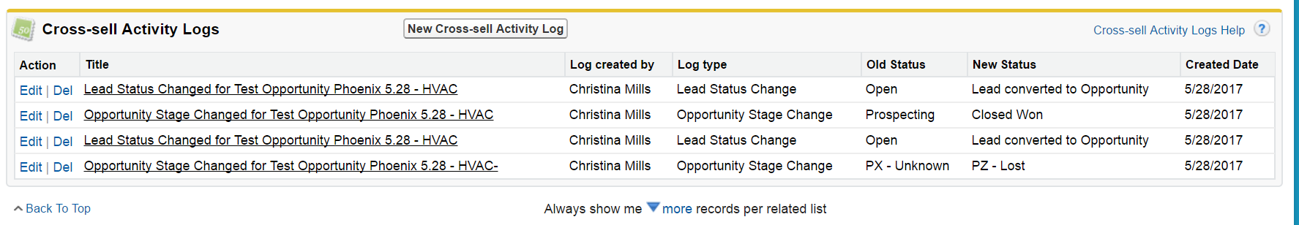
OVERVIEW
The goal of the pilot project is to enable lead management, opportunity management and dashboard reporting across multiple ME business units.
EED, PVD(Solar), HVAC are considered as candidates for this pilot.
For the initial phase of this implementation, cross-selling of the opportunities between different BUs will be a manual step. This will be achieved by a multi-selectable list of BUs on each Salesforce instance.
The user will decide if the opportunity needs to be shared with another BU and will select all BUs that the opportunity will benefit by sharing. Upon selecting BU(s) to share the opportunity, a back-end process will create a new lead in selected BU(s) with available data.
User enters Cross-selling information in the Opportunity detail to initiate sharing. Lead is created in the shared Bus. When the shared lead from the source environment is converted to an opportunity, updates for key opportunity stages in Received BU are passed back into the Cross-sell Activity Logs of the originating opportunity.

Slide 3
technical information

Slide 4
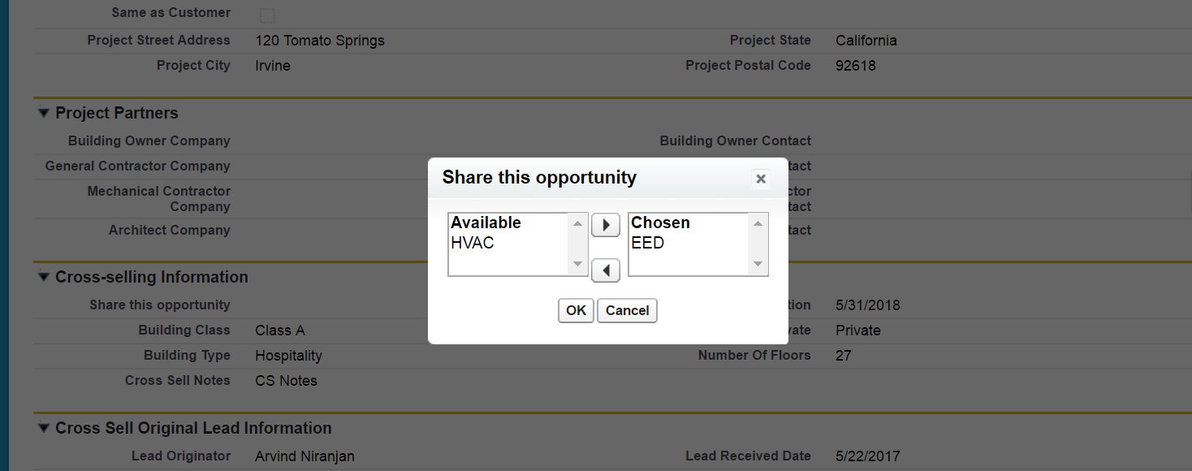
Cross-Sell Activity Logs
Cross-sell Activity Logs are created when a shared lead is converted into an opportunity, and every time a Lead or Opportunity status changes for the designated list of Lead Statuses and Opportunity Stages.
How Cross-Sell Activity Logs are Triggered
Create a new Lead or Opportunity and Share with one or more of the other BUs via the multi-select picklist.
Convert Lead to Opportunity in the Received BU.
Changing the Lead status or Opportunity Stage creates a new log for the designated list of statuses/stages
Logs can be viewed on the Lead or Opportunity page as a Related List and in the Cross-Sell Activity Logs Tab

Slide 5
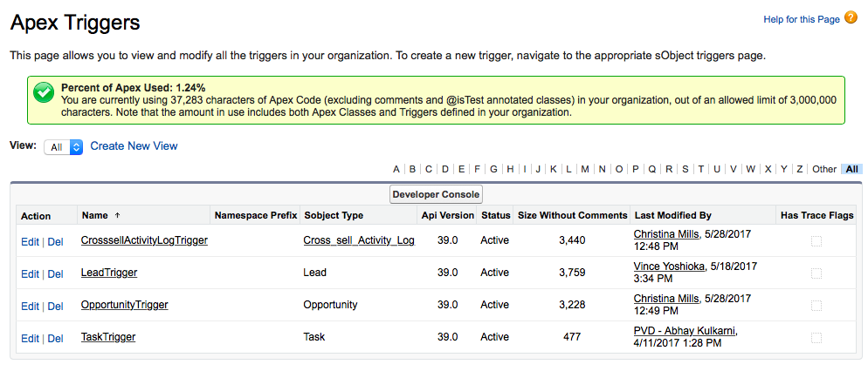
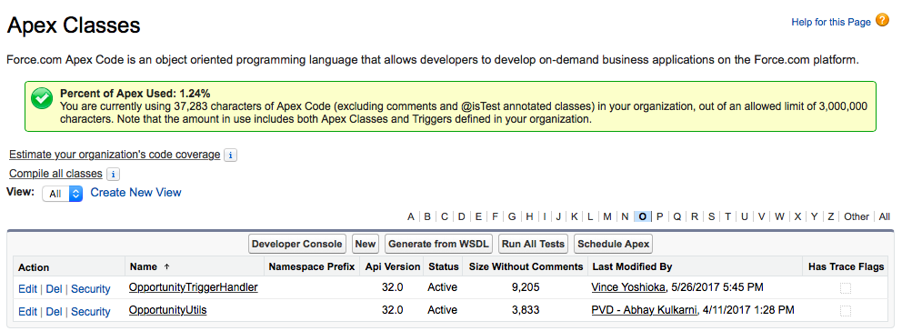
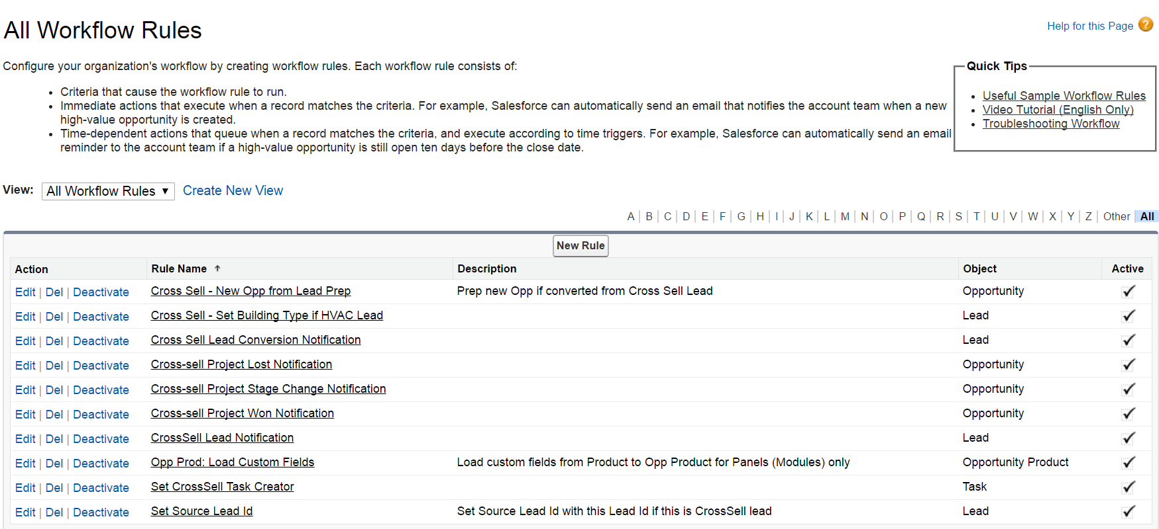
Apex Triggers, Apex Classes and Workflow Rules
Apex Triggers are found on the Leads, Opportunities (labeled Projects in HVAC), and Cross-Sell Activity Logs objects in all instances. These triggers call functions within Apex Classes to drive additional functionality to deal with automated lead generation and publishing records programmatically across the S2S mapping definition.
Workflow rules are in place to create email notifications upon status changes.
Important Triggers
Lead Triggers – Populates appropriate fields on cross-sell log
Opportunity Trigger – Populates appropriate fields on cross-sell log
Cross-Sell Activity Log Trigger – determined when a log is to be created
NOTE:
Concepts are consistent across environments, but there are code variations between them due to different stage values, additional functionality required or pre-existing code.
Sample Apex Triggers, Apex Classes and Workflow Rules from PVD environment

Slide 6
Apex Triggers, Apex Classes and Workflow Rules
The following table lists the details of Triggers, Classes, Workflow Rules in the EED environment related to the Cross-Sell Activities
Triggers | Classes | Workflow
LeadTrigger OpportunityTrigger CrosssellActivityLogTrigger | LeadUtils OpportunityTriggerHandler | Field Updates: Set Source Lead Id Set Proposal Sent Date Set Award Date Email Alerts: Cross-Sell Lead Notification (when CrossSell Lead is created) Cross Sell - New Opp from Lead Prep (When CrossSell Lead is Converted to Opportunity) Cross-sell Project Proposal Sent Notification (Stage = Proposal Sent) Cross-sell Project Hold Notification (Stage = PH – Hold) Cross-sell Project No Bid Notification (No Bid = True) Cross-sell Project Won Notification (Stage = P1 – Won) Cross-sell Project Lost Notification (Stage = PZ – Lost)

Slide 7
Apex Triggers, Apex Classes and Workflow Rules
The following table lists the details of Triggers, Classes, Workflow Rules in the PVD environment related to the Cross-Sell Activities
Triggers | Classes | Workflow
LeadTrigger OpportunityTrigger CrosssellActivityLogTrigger | LeadUtils OpportunityTriggerHandler | Field Updates: Set Source Lead Id Cross Sell - Set Building Type if HVAC Lead Email Alerts: Cross-Sell Lead Notification (when CrossSell Lead is created) Cross Sell - New Opp from Lead Prep (When CrossSell Lead is Converted to Opportunity) Cross-sell Project Stage Change Notification(Stage = Proposal/Price Quote or Negotiation/Review) Cross-sell Project Won Notification (Stage = Closed Won) Cross-sell Project Lost Notification (Stage = Closed Lost)

Slide 8
Apex Triggers, Apex Classes and Workflow Rules
The following table lists the details of Triggers, Classes, Workflow Rules in the HVAC environment related to the Cross-Sell Activities
Triggers | Classes | Workflow
LeadTrigger OpportunityTrigger CrosssellActivityLogTrigger | LeadUtils OpportunityTriggerHandler | Field Updates: Set Source Lead Id Change Lead Record Type For Cross-sell Email Alerts: Cross-Sell Lead Notification (when CrossSell Lead is created) Cross Sell - Lead Converted Notification Cross-sell Project Hold Notification (Stage = Put on Hold) Cross-sell Project Bid Notification (Stage = Bid) Cross-Sell Project Won Notification (Stage = Project Awarded,Closed Won,Order Received,Completed) Cross-Sell Project Lost Notification (Stage = Closed Lost,Cancelled)

Slide 9
Apex Triggers, Apex Classes and Workflow Rules
The following table lists the details of Triggers, Classes, Workflow Rules in the HUB environment related to the Cross-Sell Activities
Triggers | Classes | Workflow
CrosssellActivityLogTrigger |  | Field Updates: CrossSell Lead Notification Cross Sell - Set Building Type if HVAC Lead

Slide 10

Record Sharing using S2S
“Business Units (BUs)”
Shared Lead / Opportunity
S2S
Global Reporting
Forecasting
360 View of Cross Sale activity
HVAC
Opportunity Stage Updates
Shared Lead conversion to Opportunity / Opportunity update
“Management Org”
Shared Lead / Opportunity
EED
Opportunity Stage Updates
All Cross-Sell Activity
HUB
Shared Lead conversion to Opportunity / Opportunity update
Salesforce to Salesforce Integration connects the various business units so that relevant information regarding leads, opportunities, activities, and projects are in sync.
Shared Lead / Opportunity
SOLAR
Opportunity Stage Updates
Shared Lead conversion to Opportunity / Opportunity update
Additional Reference Material:
https://developer.salesforce.com/page/An_Introduction_to_Salesforce_to_Salesforce

Slide 11
Data Flow –Share from Opportunity
User Shares Opportunity
S2S
Source Org
Shared BU Org
Lead Record is Created via Opportunity Trigger and copied to Shared BU(s)
Lead Record is received into Shared BU SFDC Environment through S2S
User Converts Lead to New Opportunity in Shared Environment
User Updates Opportunity to Defined List of Stages
Activity Log Record is received back to Source Environment through S2S
Activity Log Record is Created via Opportunity Trigger / Lead Trigger and copied to Source Org

Slide 12
Data Flow – Share from Lead
Shared Org-1 Lead
Shared Org-2 Lead
Lead created in Source Org when Opportunity is shared with Org-1 and Org-2
Has Shared Lead been converted?
Has Shared Lead been converted?
Has Lead Status Changed in BU ?
Originator Org
Opportunity
Shared Org-1
Opportunity
Shared Org-2
Opportunity
Has Opportunity Stage Changed?
Has Opportunity Stage Changed?
HUB org
Activity Log Record is Created in Org-1 and pushed to Originator Opportunity/Lead
Activity Log Records are received using S2S from shared BUs
Activity Log Record is Created in Org-1 and pushed to Originator Opportunity/Lead
Related List
Activity Log End Point
Data Flow

Slide 13
Deployment steps

Slide 14
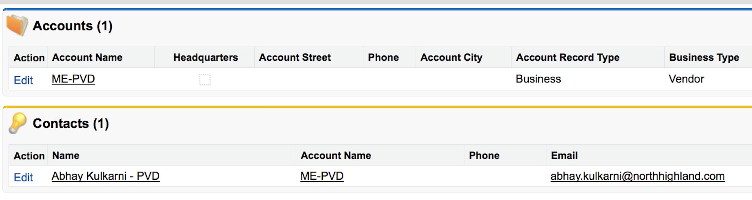
Pre-Deployment: Configure S2S in Production
Although the various Sandboxes are currently connected, the configuration must be replicated manually in the Production environments.
Go to Build -> Customize -> Salesforce to Salesforce -> Salesforce to Salesforce Settings and Enable Salesforce to Salesforce
In each instance create following Receiving Accounts to begin the connection process
ME-HUB, E-HVAC, ME-PVD, ME-EED
For each account create a contact (who will become the Connection Owner) with the name, and email address of a System Administrator from the targeted instance.

Slide 15
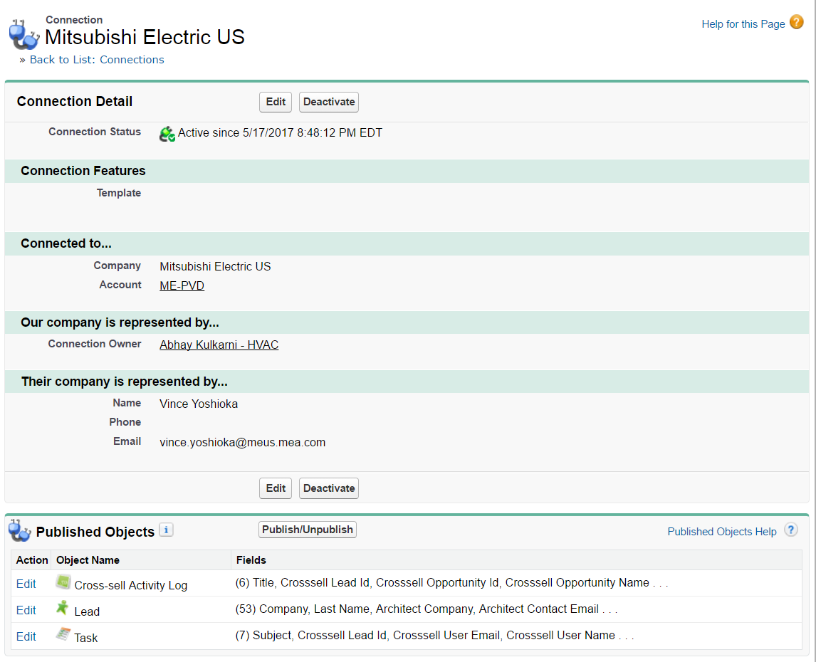
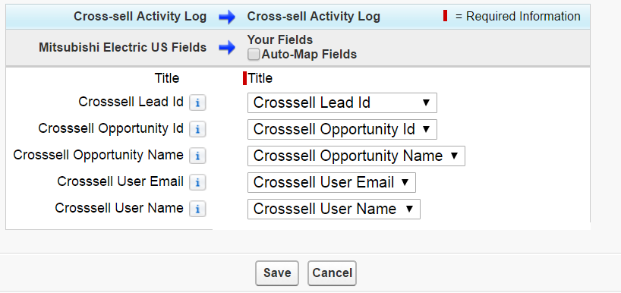
Pre-Deployment: Configure S2S in Production
These account and contacts will then be used to send invitations to connect Salesforce instances.
Once invitations are accepted, verify that objects and fields are mapped correctly

Slide 16
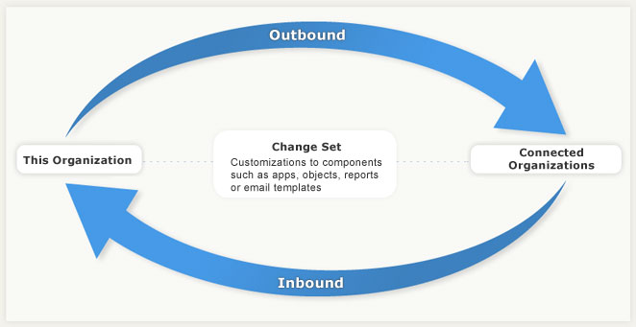
Deployment Overview
Deployment to production requires the creation of Change Sets. Outbound Change sets are created in the Sandbox and pushed over to Production.
Once logged into Production, users may accept the Change Sets, test them, and deploy them.
This process will need to be completed for each Sandbox.
Additional Reference Material:
https://help.salesforce.com/articleView?id=changesets_best_practices.htm&language=en_US&type=0

Slide 17
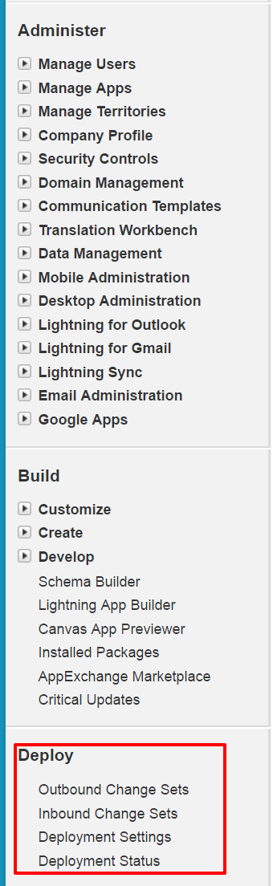
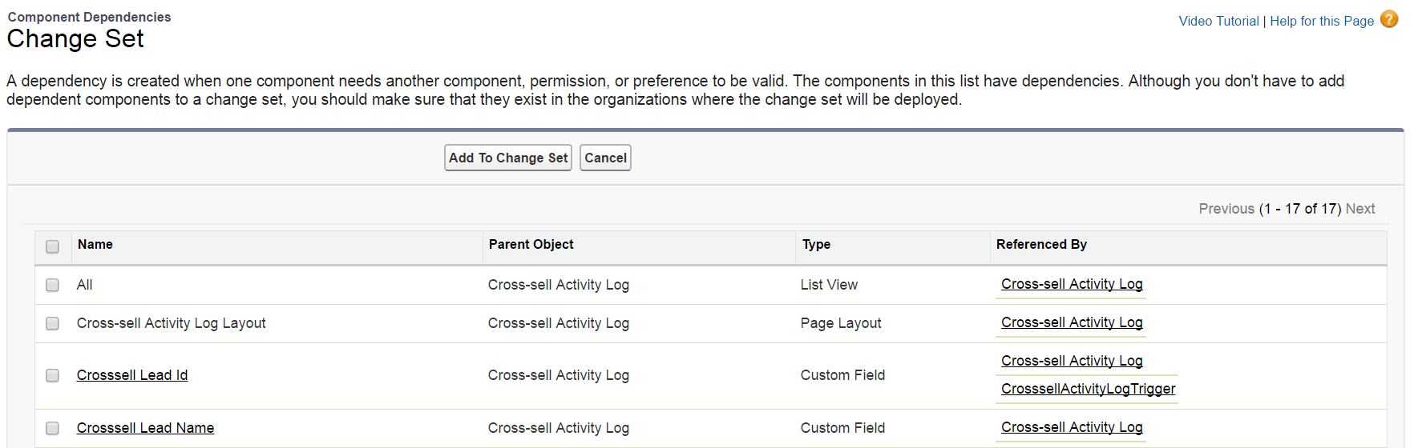
Deployment: Creating a Change Set
Select Outbound Change Sets. Create a New Change set, name it, and save.
In the Change Set Components section, click Add.
Choose the type of component (for example, Custom Object), the components you want to add, and click Add To Change Set. You may add many different components if you choose.
Click View/Add Dependencies to see whether the components you’ve added to the change set are dependent on other customizations and add them.
Ensure that you include all desired dependencies including Custom Fields, Apex, Layouts, List Views, Profiles, Permission Sets, etc.
5. Click Upload and choose your target organization, which will be
the Production environment in this case.

Slide 18
Deployment: Accepting an Inbound Change Set
Select Inbound Change Sets.
In the Change Sets Awaiting Deployment list, click the name of the change set you want to deploy.
Click Validate to view the success or failure messages that would occur with an actual deployment.
Though you do not have to validate a change set prior to deployment, this is a best practice that we highly recommend particularly when Apex, triggers, and workflows are deployed.
Please be aware that validation can take a significant amount of time if the change set is large and/or complex.
4. Once validation is successful, Select Deploy.
If the deployment is unable to complete for any reason, the entire transaction is rolled back. After a deployment completes successfully, all changes are committed to your org and the deployment cannot be undone.

